Slide 1

The
Quality Employee
Human Resources – College & Career Awareness

Slide 2

Job Applications
What do you think of each of these applications?

Slide 3

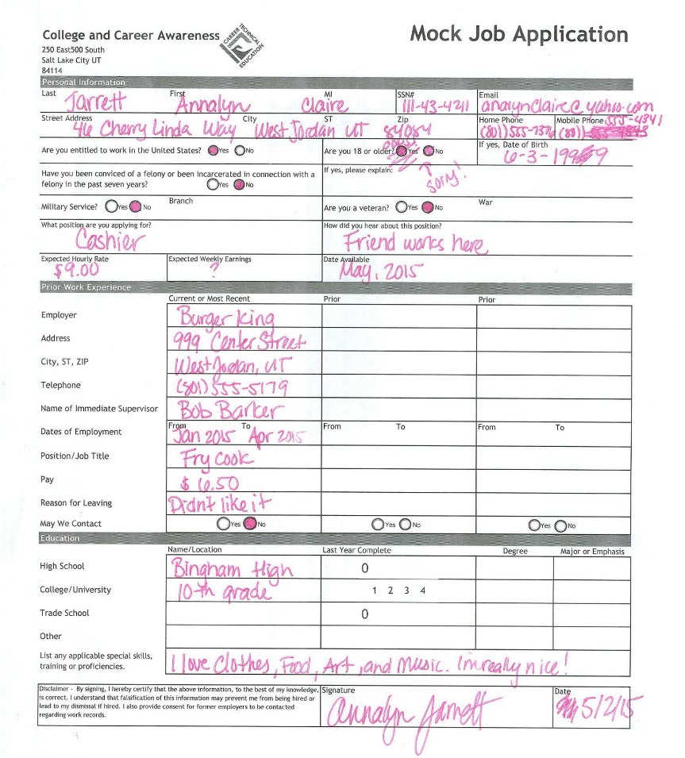

Slide 4
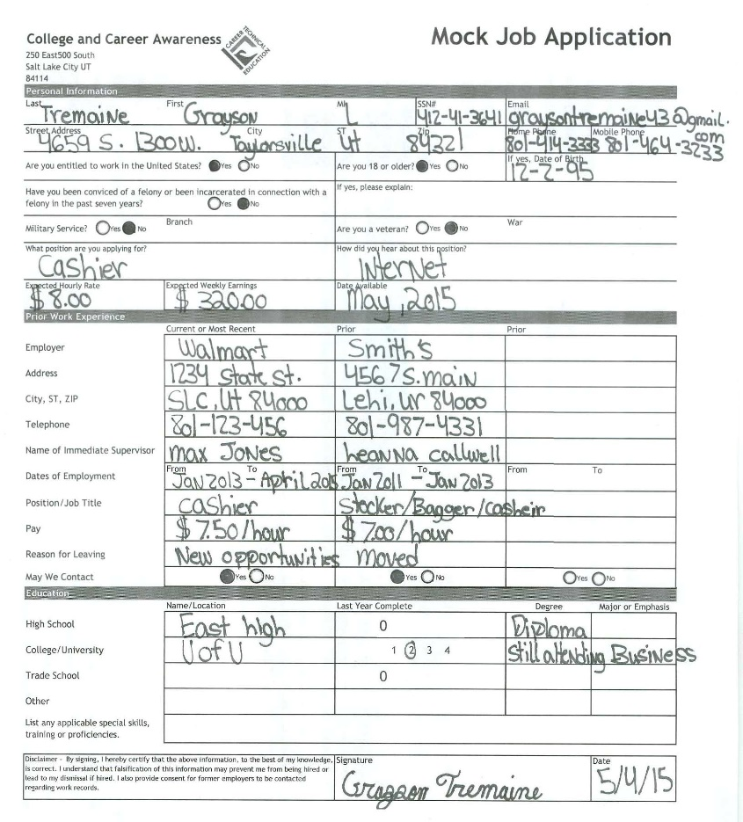

Slide 5
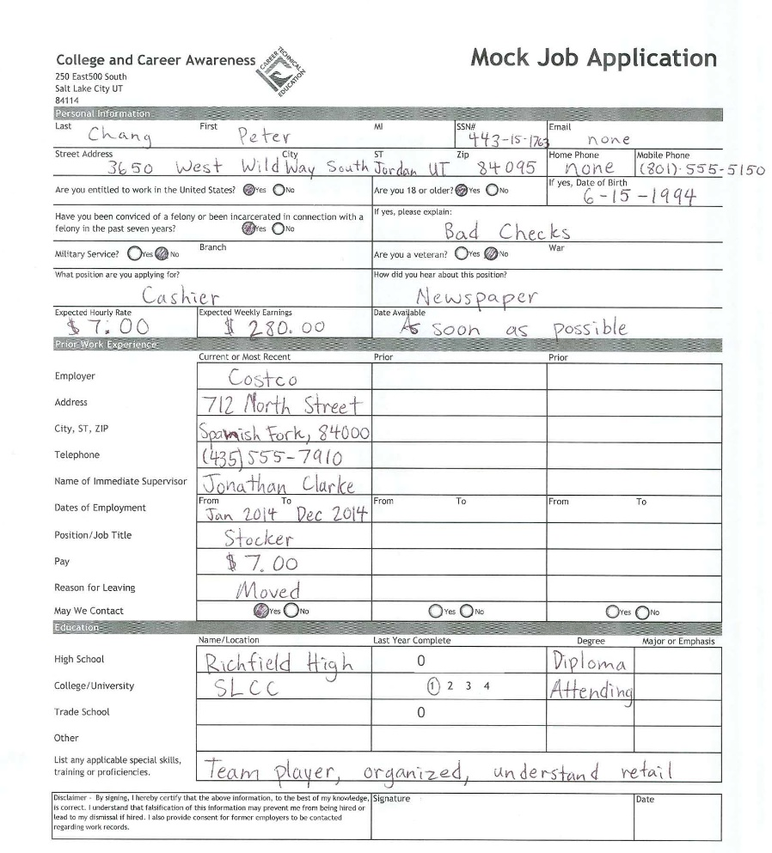

Slide 6

Soon you will become a job-seeker…
Once you understand what employers are looking for,
you can begin building your skills and personal marketing
to get the job of your dreams.

Slide 7
Before telling you what employers want…
We must first address
What Employers
DON’T Want

Slide 8

Difficult People
As you learn about difficult mannerisms,
recognize within yourself if you display anything
difficult… and then realize that you need to work on it.
Do you know any
difficult people?
How do you usually
Respond to these
People?

Slide 9
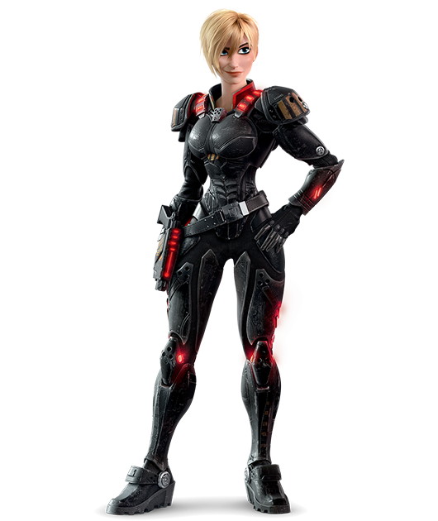
The Tank
Pushy and ruthless, loud and forceful, or with
surgical precision of a laser, the tank assumes
that the end justifies the means.
Expect no mercy!

Slide 10

The Sniper
This covert operator identifies your
weaknesses and uses them against you,
through sabotage behind your back or well
aimed putdowns in front of others

Slide 11
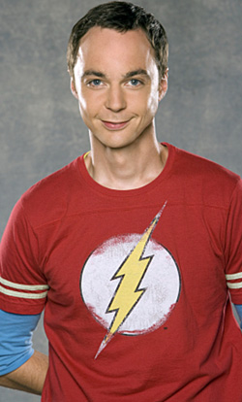
Know it All
This person knows 98% of everything. Know-it-Alls
will tell you what they know- for hours at time- but won’t
waist time to listen to your inferior ideas.

Slide 12
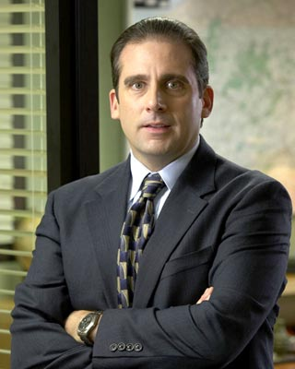
Think they know it all
This person does not know much. They just think
they do. This person exaggerates, brags, misleads, and distracts.

Slide 13

The Grenade
When they blow their tops, they are
unable to stop, and shrapnel hits everyone
in range. When the smoke clears, the cycle
begins to build again.

Slide 14
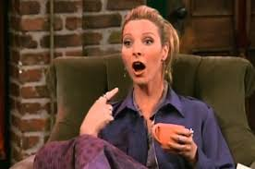
The Flake
Flaky people don’t like to say no, so they say yes—even when they don’t mean it. They can be fun and outgoing, but they are also unreliable. They don’t keep their word and are often late.

Slide 15
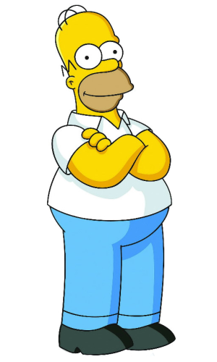
The Maybe Person
They keep putting it off until it is too late. Then the decision makes itself and becomes nobody’s fault but their
own.

Slide 16
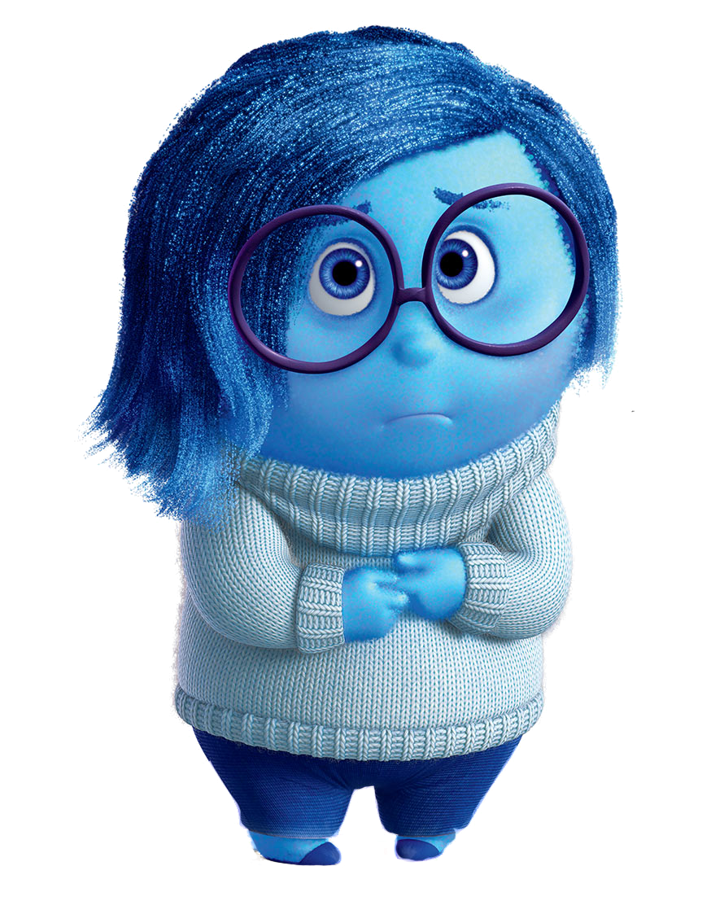
The Nothing Person
You never know what is going on
because they will never tell you. They
give no verbal feedback.

Slide 17
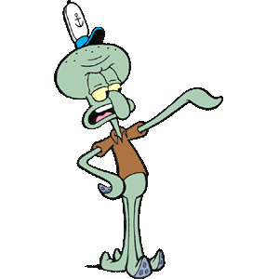
The No Person
No people don’t like to be inconvenienced
or bothered. They often say “no” because they don’t want to be interrupted. They tend to be selfish with their time.

Slide 18
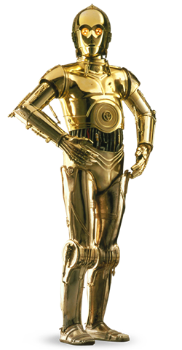

The Whiner
There is a plan for their lives, but
they are not in it. Instead they whine
continually and carry the weight of the world
on their shoulders. They never take
responsibility. Poor Me syndrome.

Slide 19
Are You That Difficult Person?
If you are, then maybe you need to work on
Your attitude
It’s time to answer questions on your worksheet under “What Employers Don’t Want”.

Slide 20
What Do
Employers Want?

Slide 21
Attitude
Your attitude is the most important skill you can develop. Employers want to hire people with a great attitude. A bad attitude can bring down a company.
This person does what
it takes to get the job done. A person
with this skill does not need to be told
what to do, instead they find tasks
to keep themselves busy and efficient.
Assertive

Slide 22
Values are attitudes and beliefs
about things we think are important
in life. Employers want to hire someone
with good values that represent their
company.
Values
Ethics are rules of personal
behavior accepted by society.
“Code of Conduct”. Employers are
looking for people that are honest
and trustworthy and always doing
the right thing.
Ethics

Slide 23

Communication
To be successful in a career, you will need good reading, writing, listening, and speaking skills.
Team Player
Did you know the #1 reason
people get fired is that they
cannot get along with team
members. Most jobs require a
person to work with others.

Slide 24

Willing to Learn
Nobody wants to work with a know it all. There is always something new to learn
Appearance
You should always dress
appropriately for your job.
People do make an impression
by how you present yourself.

Slide 25

Be The Best You Can Be!
It’s time to answer questions on your worksheet under “What Employers Want”.

Slide 26


What type of employee will you be?
Create Your Brand:
Develop your skills.
Define who you are and what you can do.
Create an application and resume.
Market what makes you different than anyone else.
Make connections and market yourself.
You have to work hard to stand out from the crowd if you want to land that perfect job. There is a lot of competition out there.

Slide 27
How to Nail an Interview

Slide 28
The First
Impression

Slide 29





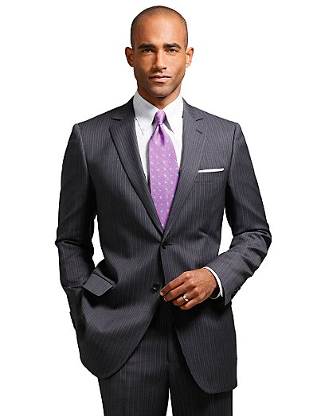


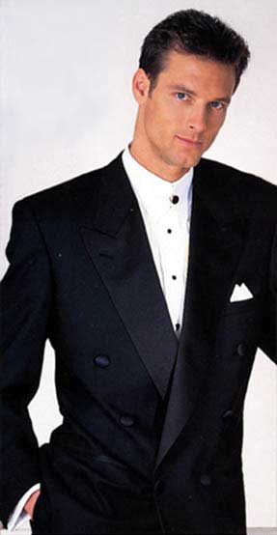



What to Wear
Yes
Or
No?

Slide 30
What to Wear
Shirt & Tie
Follow basic school rules
Be modest
No Jeans!!!

Slide 31
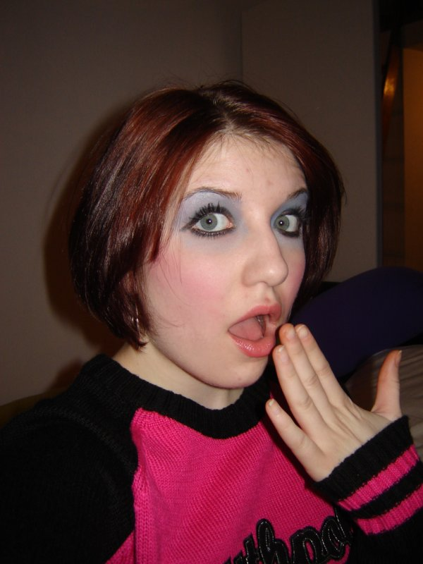
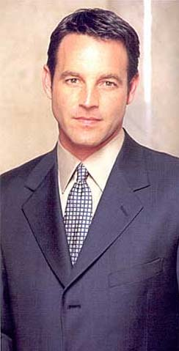


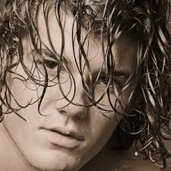
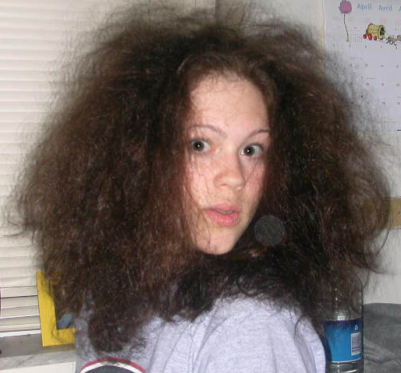
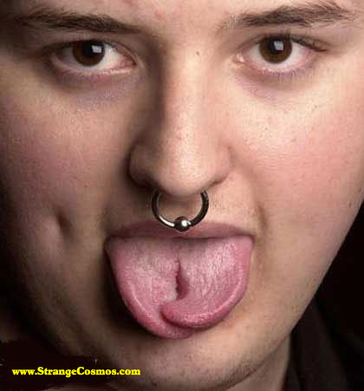

Hygiene
Yes
Or
No?

Slide 32
Hygiene
Keep your hair neatly combed and done. Nothing too crazy or wild.
Make-up, if worn, should be basic and not garish.
Don’t smell! Use deodorant!
Remove any piercing or cover and tattoos that might make you look unprofessional.

Slide 33
Be Prepared
Arrive 10 minutes early
Have your application already filled out if possible.
Bring a resume if required
Make sure you have on you the names and phone numbers of references.
Turn off your cell phone!
Don’t bring uninvited guests like parents, loved ones, or pets

Slide 34
First Interaction
Shaking Hands
Body Language
Eye Contact
Introduce yourself and say something like “I’m pleased to meet you.”
Pay attention to the interviewer’s mood—if they are formal, you should be too!

Slide 35
Speech
Try to avoid slang
Do NOT use any swear words!
Speak professionally.
Don’t say “like” and “whatever.”
Speak respectfully and at a good level.

