Slide 1
MY CAREER PATH EDUCATION

Slide 2
TYPES OF TRAINING & EDUCATION
TECHNICAL COLLEGES
UNIVERSITIES
APPRENTICESHIPS
COMMUNITY COLLEGE
CERTIFICATIONS

Slide 3
DEGREES 1,2, 4 OR MORE!
DOCTORATE
CERTIFICATION
ASSOCIATES
MASTERS
1
4
BACHELORS
2
MORE

Slide 4
How do I PAY FOR IT?
PERSONAL SAVINGS
FAMILY
SCHOLARSHIPS
PEL GRANT
GET A JOB!
WORK-STUDY
STUDENT LOANS

Slide 5
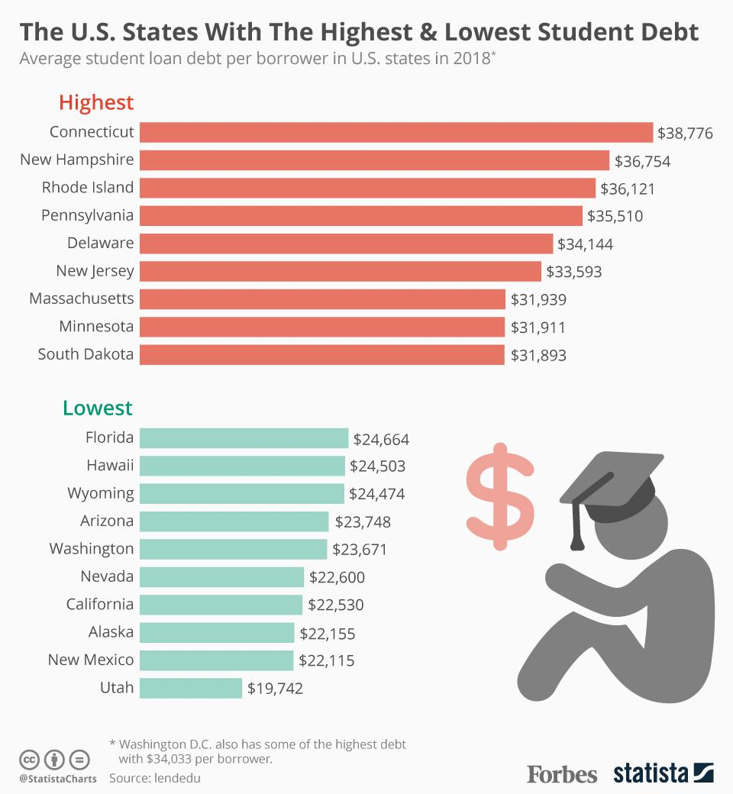
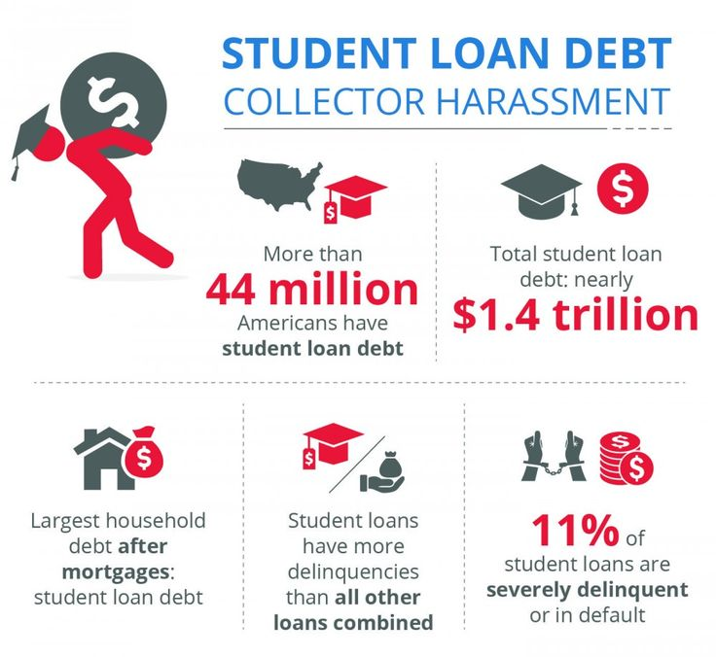
How do I PAY FOR IT?
STUDENT LOANS

Slide 6
TUITION RATES
IN-STATE
OUT OF STATE
$8,615
$27,220

Slide 7
 | $8,615
 | $5,620
 | $33,480
 | $3,326
 | $3,369
 | $7,056
 | $14,220
COLLEGE COMPARE

Slide 8
SCHOLARSHIPS
ACADEMIC
AVERAGE ACADEMIC
COMMUNITY SERVICE
CREATIVE
WOMEN
UNUSUAL
MINORITIES
ATHLETIC

