Slide 1
Do You Have What it Takes?
Entrepreneurship
By Megan Rees

Slide 2
What is an Entrepreneur?
A person who organizes and operates a business or businesses, taking on greater than normal financial risks in order to do so.

Slide 3
Types of Entrepreneurs
The Builder
The Opportunist
The Specialist
The Innovator
http://www.forbes.com/sites/georgedeeb/2014/11/07/the-4-types-of-entrepreneurs-which-type-are-you/#4af15b574c56

Slide 4
Builder
Loves to build the business. Type of business is less important than the fact that it can be built to conquer.
Motivated by: Infastructure
Strengths: Raising money, putting systems in place, launching the business.
Tempermental, controlling, unreasonable. Get bored if business plateaus.

Slide 5
Opportunist
Speculator and a risk-taker. Want to be at the right place at the right time and make money as fast as possible. Will work incredibly hard if the reward is big enough.
Motivated by: Amount of money they make while not working
Strengths: Motivated, extremely positive, hard worker, natural born sales person. Failure is a minor irritation
Impulsive, quickly lose focus, prone to making snap decisions

Slide 6
Specialist
Develop a skill, and build a business around that skill. Their business is based on expertise and the ability to deliver a product or service. Accountants, plumbers, doctors—are all specialists. Not in it to get rich quick, but to be their own boss.
Motivated by: Personal Incom
Strengths: Focused, analytical, methodical, highly skilled.
Weaknesses: Standing out and marketing. Slow to see opportunities to expand, diversify, and grow.

Slide 7
Innovators
Don’t plan to be an entrepreneur; instead they tinker with a recipe, program, or concept and a business popped up around it. Innovators want to do research and development, create the next cool thing—not build the next cool company.
Motivated by: Impact of their product or service on mankind
Strengths: Inovative, creative, able to develop breakthrough intellectual properties
Weaknesses: Don’t’ know anything about business, management, finance…and don’t really care to learn.

Slide 8
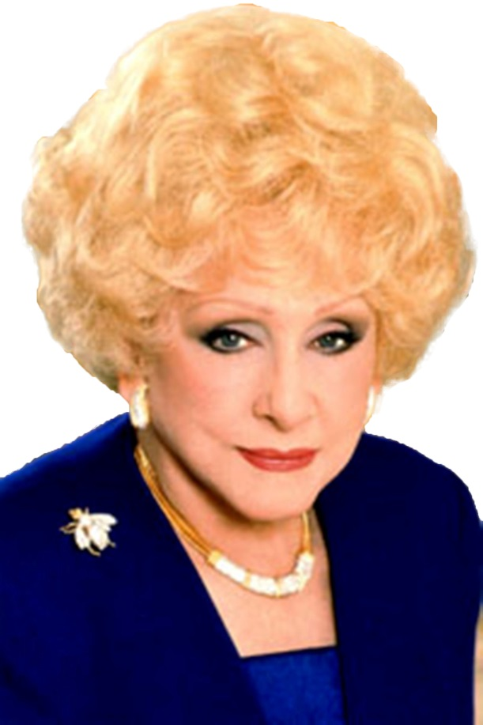
Who’s Who In Entreprenoo?
Mary Kay Ash
Lifespan: 1918-2001
From: Texas, USA
Company: Mary Kay Cosmetics
Achievement: Built a global independent sales force that numbers more than 3 million women. Author of several books. Used an incentive program to reward employees.

Slide 9
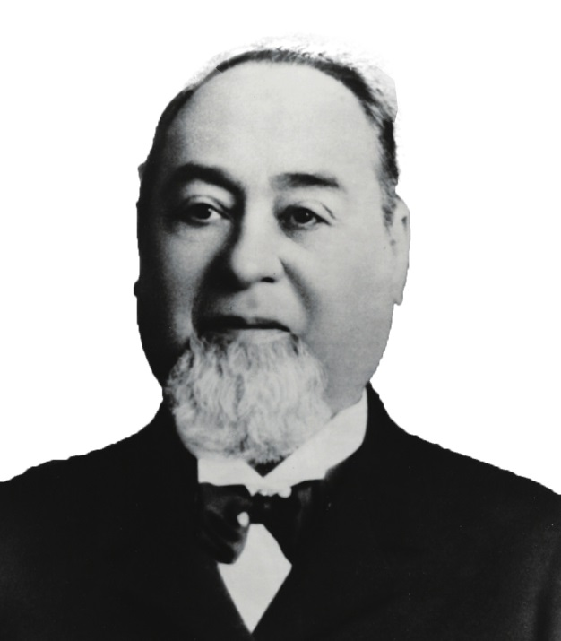
Who’s Who In Entreprenoo?
Levi Strauss
Lifespan: 1829-1902
From: American/German, Jewish
Company: Levi Strauss
Achievement: Emigrated from Germany to America at the age of 18. Worked at his family’s dry goods store. Wsent out west during the Gold Rush, and began making heavy duty pants, now called jeans, for the workers.

Slide 10
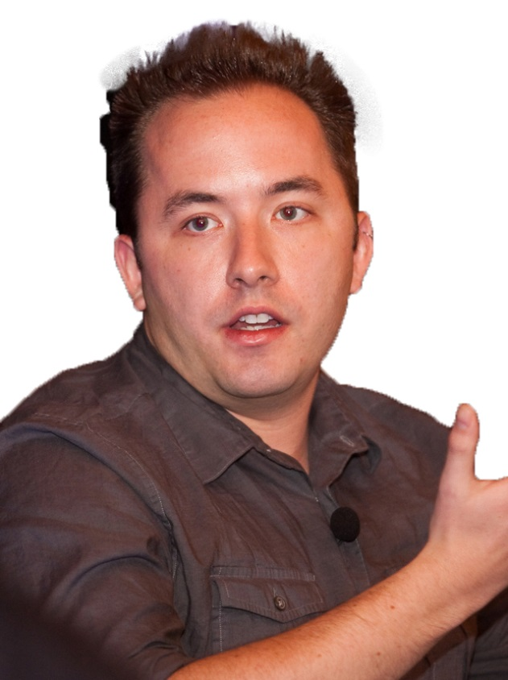
Who’s Who In Entreprenoo?
Drew Houston
Lifespan: 1983 - Present
From: Massachusetts, USA
Company: Dropbox
Achievement: Left his flash drive home one day and couldn’t do any work at work, so he started writing code to solve the problem, and Dropbox was born. The service allows users to access files from a cloud source.

Slide 11
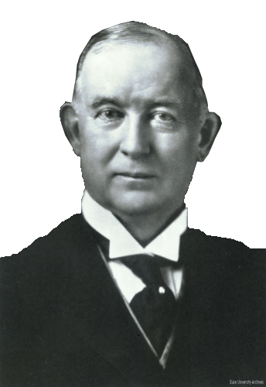
Who’s Who In Entreprenoo?
James Buchanan Duke
Lifespan: 1856-1925
From: North Carolina, USA
Company: Cigarettes, Duke University
Achievement: Owned a tobacco company, started using the first automated cigarette making machine. Bought out his competitors to make the American Tobacco Company, which was a monopoly. Also went after all British Markets, but was unsuccessful. Eventually forced to split his companies, due to monopoly laws. Also ran an enormous power company. At his death, his $40 million trust fund was donated to Trinity College, which was renamed Duke University.

Slide 12
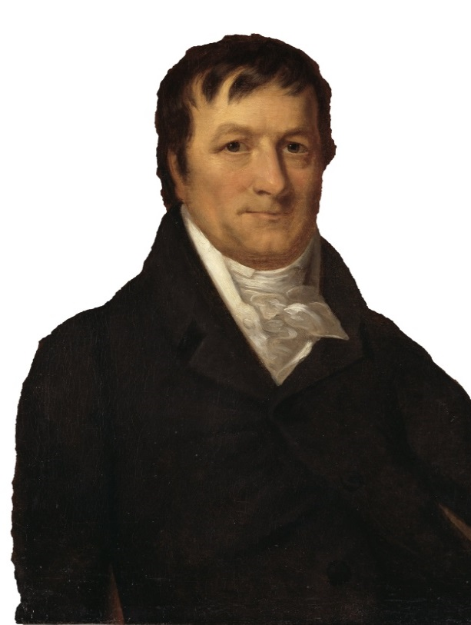
Who’s Who In Entreprenoo?
John Jacob Astor
Lifespan: 1763-1848
From: Germany/USA
Company: Fur trade/Real Estate
Achievement: Immigrated to New York just after the Revolutionary War. Built his fortune on the fur trade. Sold out when the fur trade started to tank, and began buying up land in New York City. Correctly predicted New York’s rapid growth in Manhattan Island.

Slide 13
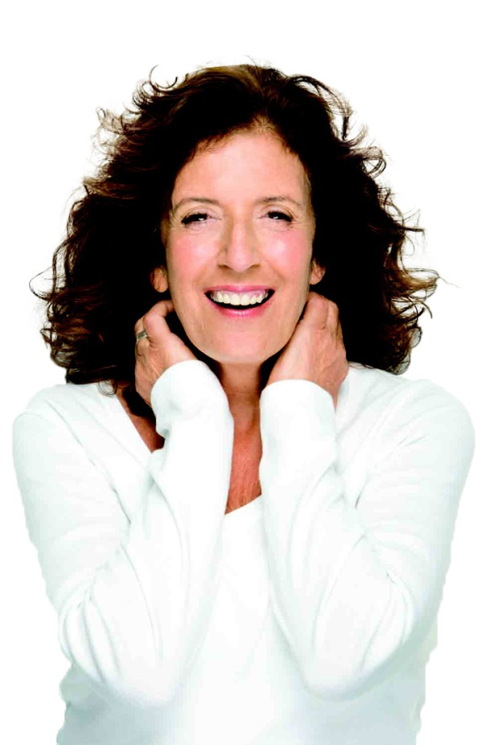
Who’s Who In Entreprenoo?
Anita Roddick
Lifespan: 1942-2007
From: Great Britain
Company: The Body Shop
Achievement: Opened the Body Shop in 1976. By 1991, she had 700 branches. Prohibited testing on animals. By 2004, there were 1980 stores worldwide. L’Oreal purchesed The Body Shop in 2006 for 652 Million pounds.

Slide 14
Qualitites of an Entrepreneur
http://www.forbes.com/sites/aileron/2013/11/26/the-top-skills-every-entrepreneur-needs/#6d5aa6245669

Slide 15
#1 Resiliency
The ability to weather the ups and downs of any business since it never goes exactly the way the business plan described it. This skill enables the entrepreneur to keep going when the outlook is bleak.

Slide 16
#2 Focus
After setting a long term vision, knowing how to “laser focus” on the very next step to get closer to the ultimate goal. There are so many distracting forces when trying to build a business that this skill is not easy to master.

Slide 17
#3 Invest for the Long-Term
Most entrepreneurs are not patient and focus only on what comes next, rather than where the company needs to go. Overnight success may take 7 to 10 years. Entrepreneurs need to stop, pause and plan on a quarterly basis.

Slide 18
#4 Find and Manage People
Only by learning to leverage employees, vendors and other resources will an entrepreneur build a scalable company. They need to learn to network to meet the right people. Entrepreneurs strive to guarantee they will get honest and timely feedback from all these sources.

Slide 19
#5 Sell
Every entrepreneur is a sales person whether they want to be or not. They are either selling their ideas, products or services to customers, investors or employees. They work to be there when customers are ready to buy. Alternately, they know how to let go and move on when they are not.

Slide 20
#6 Learn
Successful entrepreneurs realize they don’t know everything and the market is constantly changing. They stay up to date on new systems, technology, and industry trends.

Slide 21
#7 Self-Reflection
Allow downtime to reflect on the past and plan for the future. Always working only leads to burnout physically and emotionally.

Slide 22
#8 Self-Reliance
While there is a lot of help for the entrepreneur, in the end, they need to be resourceful enough to depend on themselves.

Slide 23
Are YOU an entrepreneur?
Take the Quiz!

