Slide 1
Agriculture
By Megan Rees

Slide 2
Food Worship
How many careers are mentioned or referred to in this clip alone?

Slide 3
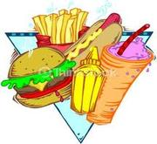
Food
Grow it
Distribute it
Eat it
Prepare it
Deliver it
Transport it
Make it
Excrete it
Throw it away
Have enough of it
Give to those who need it
Raise it
Slaughter it
Package it
Catch it
Hunt it
Gather it
Preserve it
Produce it
Conserve it
Store it
Research it
Process it

Slide 4
“Agriculture” also refers to:
Animal Health
Animal Diseases, well-being, research
Biotechnology
Genetic engineering, technology in farming
Conservation
Healthy soil, water air, plants, animals and ecosystems
Emergency Preparedness & Response
Tools and resources to provide food in the event of a disaster
Energy
Compare and analyze biofuels and bioenergy data
Food & Nutrition
Nutrition assistance to families in need
Food Safety
Managing safety in food processing and distribution
Forestry
Create diverse, integrated, productive, profitable healthy and sustainable land-use systems
Marketing and Trade
Trade agreements & research to expand and maintain foreign and domestic markets
Organic Agriculture
Increasing the number of organic operations which preserve the environment and avoid synthetic materials.
Plant Health
Reduce losses by plant diseases that are effective and affordable
Research & Science
Using science and research to solve problems in conservation, climate change, food security, etc.

Slide 5
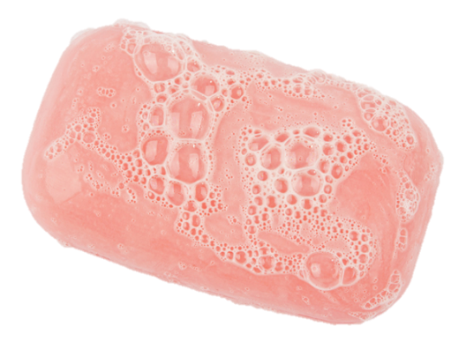
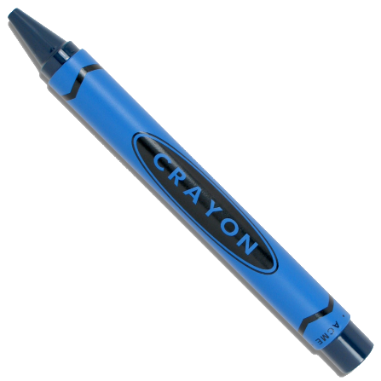
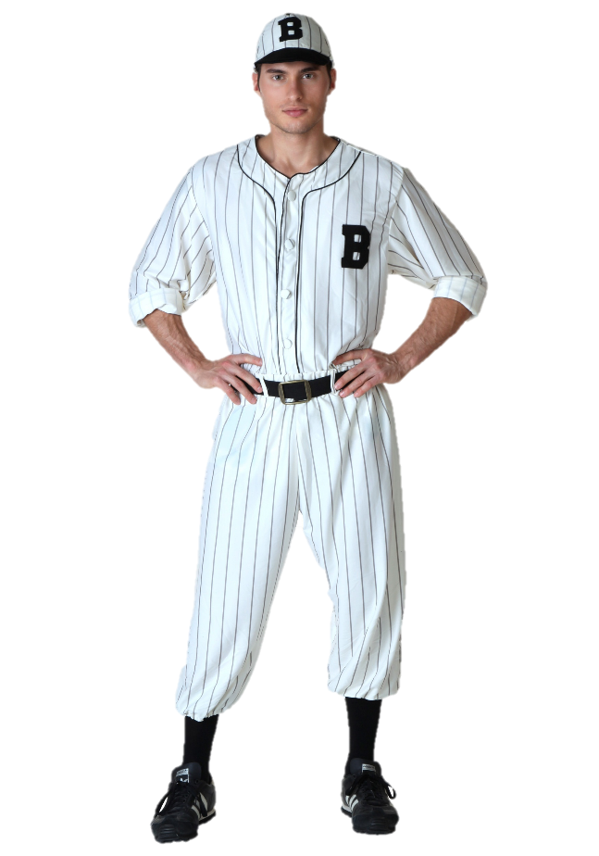
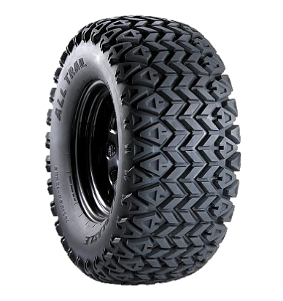
Agriculture is more than food
Many products we use every day are animal byproducts
Manufacturing
Construction
Healthcare
Personal Care Products
Transportation
Sports
Printing
Education
Entertainment
Adhesives, lubricants, solvents, detergents, polymers
Lumber, paints, brushes, tar paper, drywall, tool handles, particleboard
Pharmaceuticals, surgical sutures, ointments, latex gloves, X-ray film
Shampoo, soap, cosmetics, lotions, fingernail polish, toothpaste
Biofuels, lubricants, antifreeze, tires, upholstery, packing materials
Uniforms, baseball bats, leather equipment and balls, shoes
Paper, ink
Crayons, textbooks, chalk, desks, pencil, paper
Strings for musical instruments

Slide 6
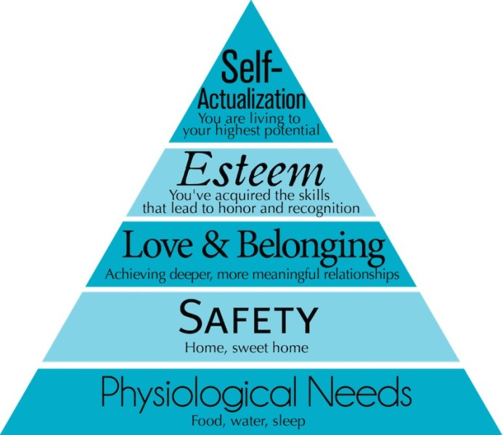
Agriculture Supports Our Basic Needs
Physiological needs are the #1 concern for every person on the planet.
You can’t focus on your need for love and acceptance, for example, if you are worried about breathing, or you are starving!
Therefore, Agriculture careers are at the heart of the basic needs for every living thing.

Slide 7
Change in Statistics
1776 – 98% Farmers
1950 – 12% Farmers
2010 – 2% Farmers
1776 Population – 76 Million
2013 Population – 316 million
And yet—we feed more people both domestically and foreign than ever before. HOW?
Less people growing food, more people needing food
Technology
Growing food with less land and fewer producers.

Slide 8
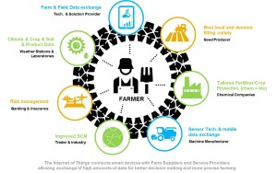
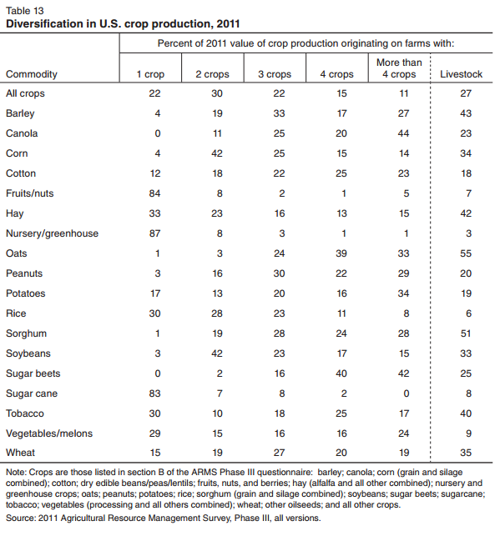
Data Collection - USDA
The USDA (founded by Abraham Lincoln) gathers massive amounts of data.
This data is about consumer information, producer data, production data, and economic data, and data about America’s workforce.
They measure labor market activity, working conditions, and price changes in the economy.

Slide 9
Types of Graphs

Slide 10
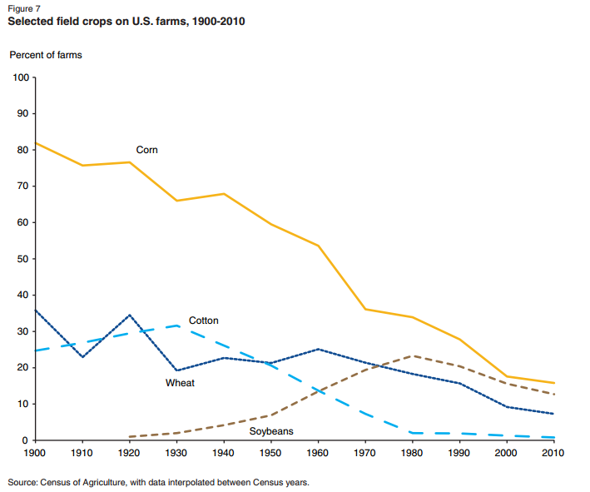
Line Chart
Compare improvement and decline
Change over time

Slide 11
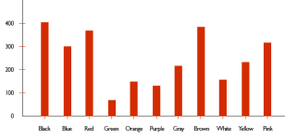
Column and Bar Charts
Column Charts and Bar Charts are interchangeable, but sometimes one is better than the other depending on the information you are graphing
Compare multiple sets of data

Slide 12
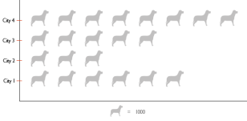
Pictographs
Using pictures or small symbols to compare information.
Generally used in column and bar charts.

Slide 13
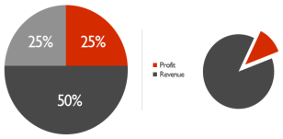
Pie Charts
Parts of the whole
Uses percentages
Can only graph ONE set of data

Slide 14
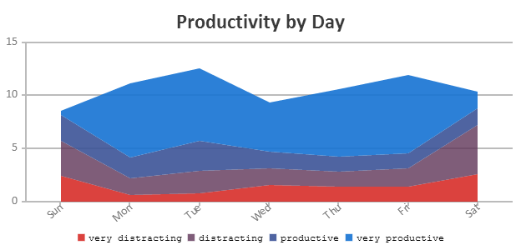
Area Charts
An area chart or area graph displays graphically quantitive data. It is based on the line chart. The area between axis and line are commonly emphasized with colors, textures and hatchings. Commonly one compares with an area chart two or more quantities.

Slide 15
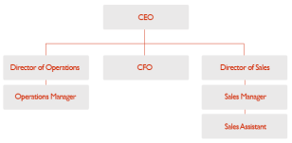
Organizational Charts
Diagrams that represent relationships between the different positions and ranks of a company through a series of boxes

