Slide 1
What are Pathways?
By Megan Rees

Slide 2
Choose a Pathway!
Business
Health Science
Family & Consumer Science
Skilled & Technical Sciences
Agriculture
Marketing
Technology & Engineering
Information Technology

Slide 3
Business
1
2
3

Slide 4
Business – Question 1
Which of these careers belongs in the business pathway?
Lawyer
Physical Therapist
Computer Programmer

Slide 5
Business – Question 2
Which of the following careers makes the most money?
Human Resource Manager
Interviewing Clerk
Business Agent

Slide 6
Business – Question 3
What percent of college students major in Business?
50%
20%
12%

Slide 7
Information
Technology
1
2
3

Slide 8
Information Technology – Question 1
Which of these occupations makes $132,000 a year?
Computer Programmer
Database Administrator
IT Manager

Slide 9
Information Technology – Question 2
Which of these careers is the only one to NOT score a 5-star rating? (high pay and high demand)
Video Game Designer
Computer Engineer
Natural Sciences Manager

Slide 10
Information Technology - 3
Which of the following state is in the top 10 for HIGHEST PAY for Information Technology?
Iowa
Utah
Kentucky

Slide 11
Family & Consumer Science
1
2
3

Slide 12
FACS – Question 1
Which of these careers makes the most money?
Fashion Designer
Chef
Interior Designer

Slide 13
FACS – Question 2
Which of these classes does NOT in the FACS pathway?
Psychology
Foods & Nutrition
Clothing

Slide 14
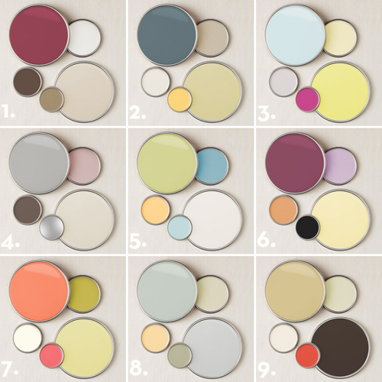
FACS – Question 3
Which of these images does NOT belong in the Family and Consumer Sciences pathway?

Slide 15
Agriculture
1
2
3

Slide 16
Agriculture – Question 1
Which of these sciences aligns least with Agriculture careers?
Biology
(study of life)
Anthropology
(study of human culture)
Entomology
(study of insects)

Slide 17
Agriculture – Question 2
Which of these careers belongs in the Agriculture pathway?

Slide 18
Agriculture – Question 3
What percentage of the United States is farmland?
40%
20%
60%

Slide 19
Skilled & Technical Sciences
1
2
3

Slide 20
Skilled & Tech – Question 1
Which of the following is NOT a career in Skilled and Tech?
Cosmetologist
Car Mechanic
Radio Broadcast Technician
Fire Fighter
Air Traffic Controller
Nail Technician
Physicians Assistant
Police Officer
Photographer
Makeup Artist
Welder
Electrician

Slide 21
Skilled & Tech – Question 2
How many years of school is average for Skilled and Tech careers?
Less than a year
4 Years
2 Years

Slide 22
Skilled & Tech - Question 3
Which of these careers makes the least amount of money?
Carpenter
Cosmetologist
Plumber

Slide 23
Technology & Engineering
1
2
3

Slide 24
Tech & Engineering – Question 1
Which type of engineer design and/or tests roller coasters?
Mechanical
Engineering Technician
Electrical

Slide 25
Tech & Engineering – Question 2
Which type of engineer makes $132,320 a year?
Chemical
Petroleum
Aerospace

Slide 26
Tech & Engineering - 3
Which of these fictional characters does NOT have a job in the Tech & Engineering pathway?

Slide 27
Health Science
1
2
3

Slide 28
Health Science – Question 1
Which occupation gets paid the most?
Registered Nurse
Nursing Assistant (CNA)
Medical Assistant
Physician’s Assistants
Licensed Practical Nurse (LPN)

Slide 29
Health Science – Question 2
Which of these classes are associated with Health Science?
Anatomy
Sociology
Psychology
Physiology

Slide 30
Health Science – Question 3
Which of these areas is NOT covered in the Health Science Pathway?
Physical Body
Mental Health
Nutrition

Slide 31
Marketing
1
2
3

Slide 32
Marketing – Question 1
Which of these images is NOT related to Marketing?

Slide 33
Marketing – Question 2
Which of these careers is a 5-star rating career? (high pay and demand)
Real Estate Agent
Advertising Manager
Purchasing Agent
Model
Cashier
Customer Service Rep.
Hotel Manager

Slide 34
Marketing- Question 3
Which of the following has more education than high school?
Parking Lot Attendant
Service Station Attendant
Floral Designer
Retail Salesperson
Stock Clerk
Market Research Analyst
Property and Real Estate Manager
Travel Agent
Hotel Desk Clerk
Cosmetologist
Telemarketer
Recreation Guide

Slide 35
Try Again!

Slide 36
Correct!

