Slide 1
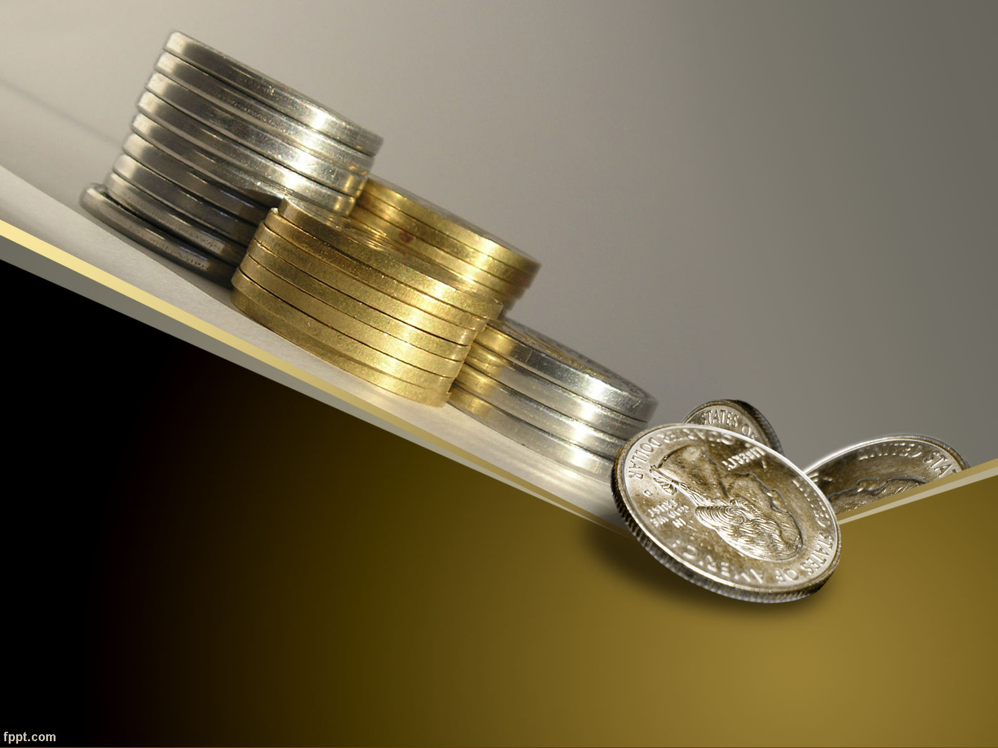
Managing Your Money with a Checking Account
Information taken from financeintheclassroom.org

Slide 2
Why Do You Want a Checking Account?
Money is kept safe
A record is kept of what you spend and what you earn
You gain interest on the money you put in the bank
There are protections against fraud

Slide 3
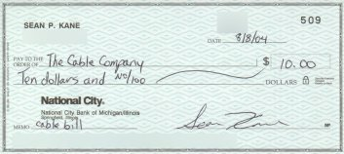
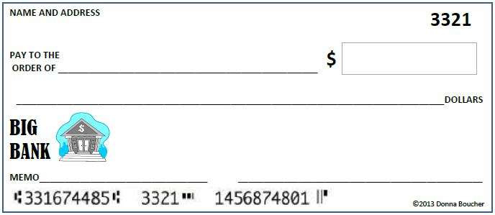
Rules to Using a Checking Account
Only write check when you have enough money in your account
When you disregard this rule, it is called a “bounced check”
Write checks legibly.
Write the amount as far to the left as possible.
14.56

Slide 4
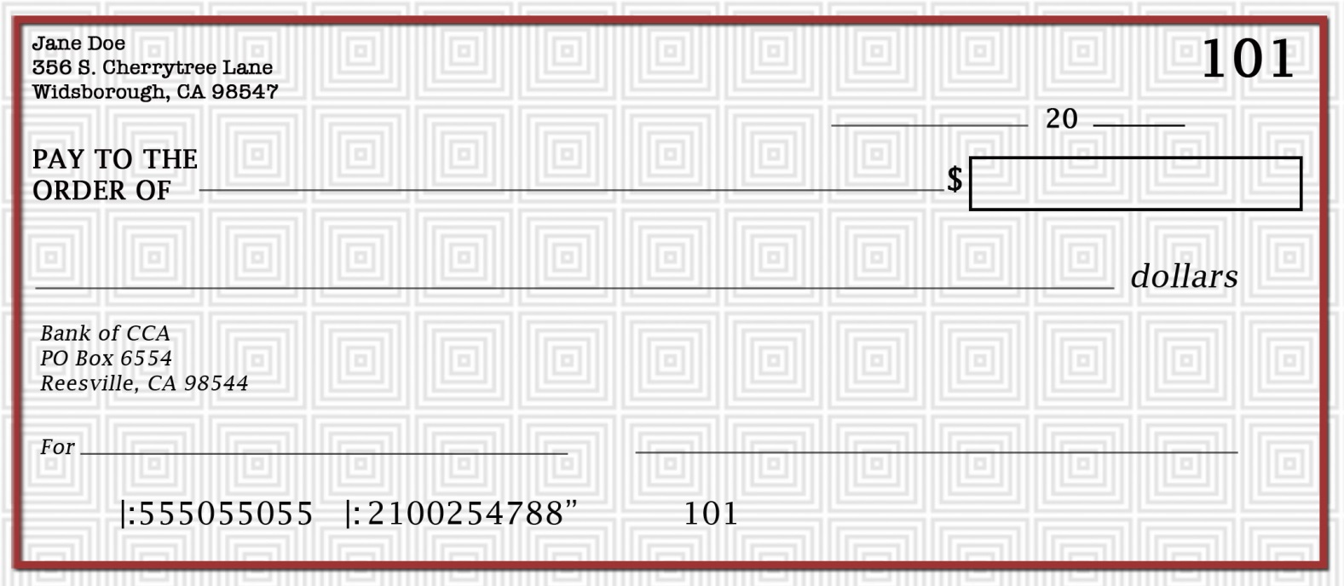
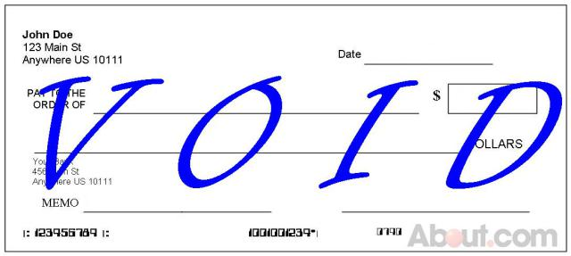
Rules to Using a Checking Account
Always use a pen
Don’t sign a blank check
Can this check be cashed?
Print the right date on checks
Keep checks in a safe place
Destroy voided or unused checks
12/15
16
Lisa Willis
200.00
Two hundred and 0/100
Tickets
Michael Sansweet

Slide 5
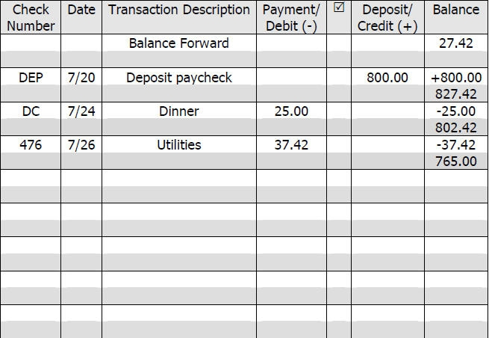
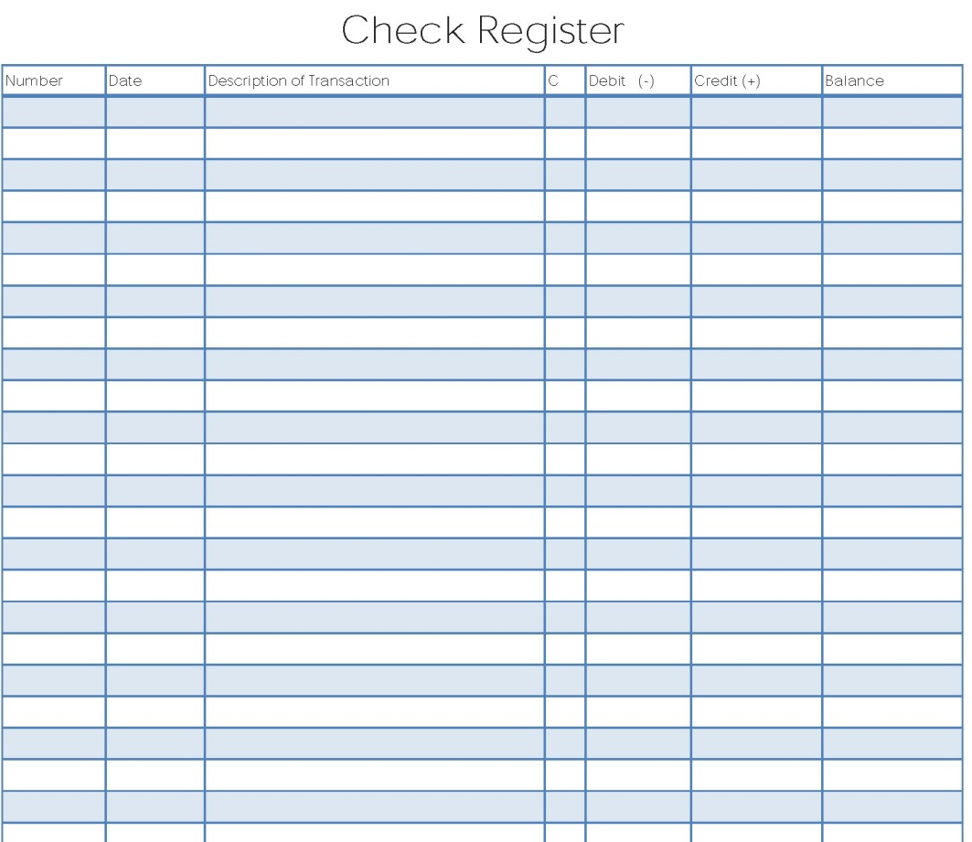
Rules to Using a Checking Account
Record every transaction in your register
Keep a running balance in the register

Slide 6
Writing a Check
1
Date the check. Generally, you do not want post-date it in case you do not have the funds to cover it.
2
Write the name of the person or place that you are giving the money to. If it is a person, use a first and a last name.
3
In dollars and cents, write the amount of the check, staying close to the dollar sign.
1
5/1 16
Alyssa Johnson
2
21.67
3

Slide 7
Writing a Check
4
Spell out the amount in words, using 0/100 format for cents. This makes it much harder to fraud your check. Draw a line to the end.
5
Sign your name in cursive. You must have a signature that is relatively the same every time you sign.
6
After the word “for” you can list what the check is for, but it’s not required.
5/1 16
Alyssa Johnson
21.67
4
Twenty-One and 67/100 ---------------------------------------
Jane Doe
Theater Tickets
6
5
Account Number
Routing Number
Check Number

Slide 8
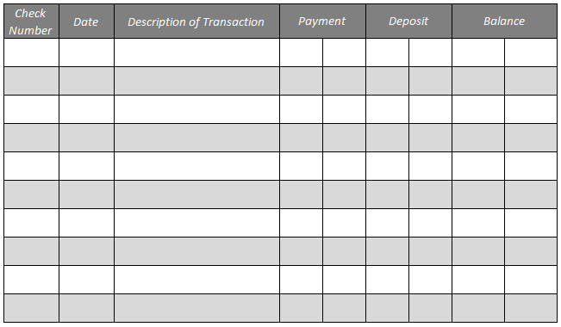
Recording Deposits, Checks, or Withdrawals
1
Write the check number in this space. You can also write “DEB” for a debit, or “DEP” for deposit if you want.
2
Enter the date.
3
Write who the check is for. If it’s a deposit, write “deposit.”
675 35
1
101
5/1
Alyssa Johnson
3
2

Slide 9
Recording Deposits, Checks, or Withdrawals
4
If you are SPENDING money—either by check, ATM withdrawal, or debit, enter the amount you are withdrawing.
5
If making a deposit, the amount goes in the deposit column.
6
Write your balance here. Subtract money you spent, and add money you put in.
4
6
675 35
101
5/1
Alyssa Johnson
21 67
653 68
803 68
5/6 Deposit 150 00
5
Keeping a running balance keeps you aware of how much money is in your account so you do not bounce a check. Bouncing checks will rack up fees very quickly!

